Slide 1
NFR
Imran Mahmud

Slide 2
Non-functional requirements define the overall qualities or attributes of the resulting system - Non-functional requirements place restrictions on the product being developed, the development process, and specify external constraints that the product must meet. - Examples of NFR include safety, security, usability, reliability and performance requirements. -Project management issues (costs, time, schedule) are often considered as non-functional requirements as well

Slide 3
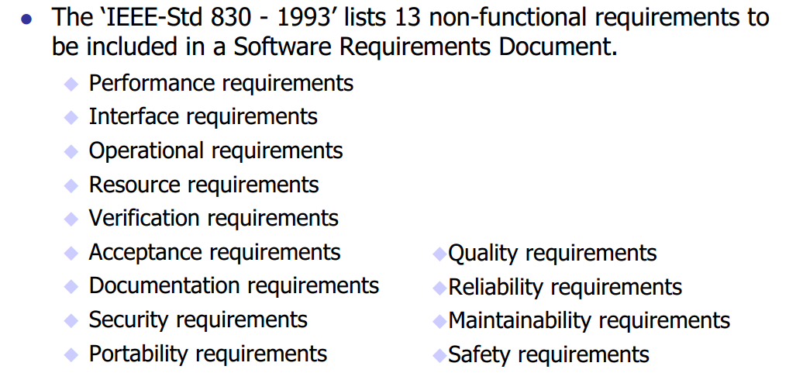

Slide 4
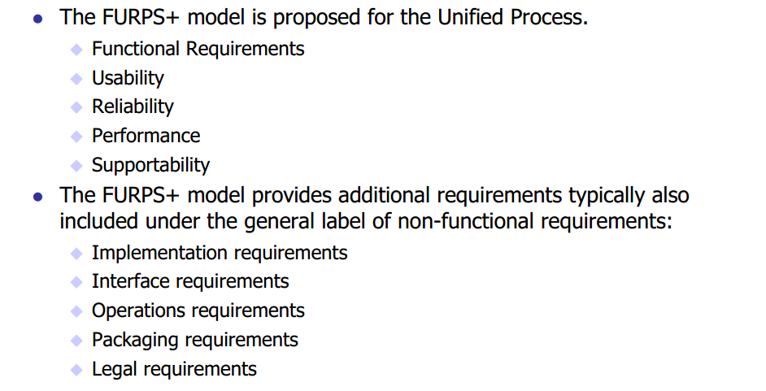

Slide 5
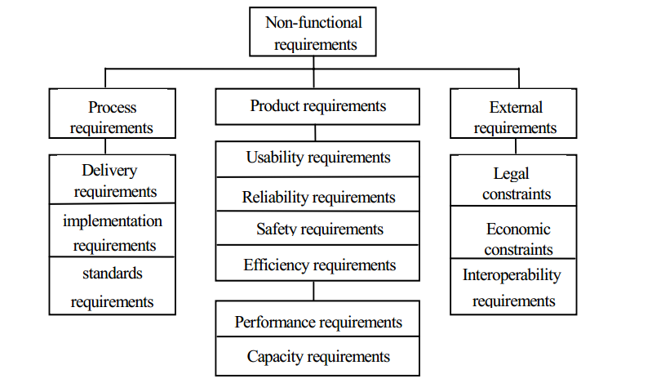

Slide 6
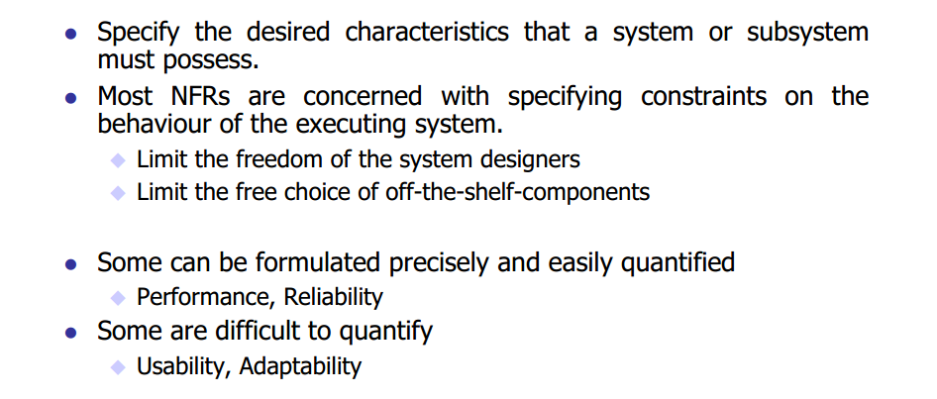
Product Requirement

Slide 7
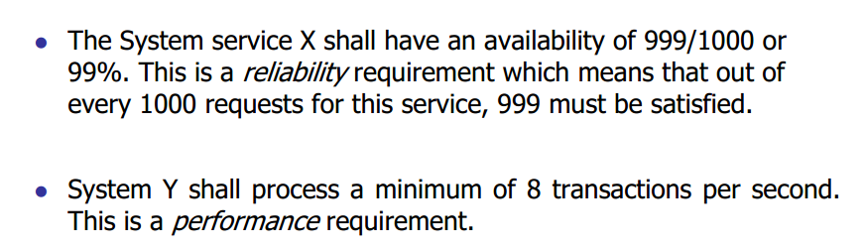
example

Slide 8
Usability
Jakob Nielsen 10 Heuristics

Slide 9
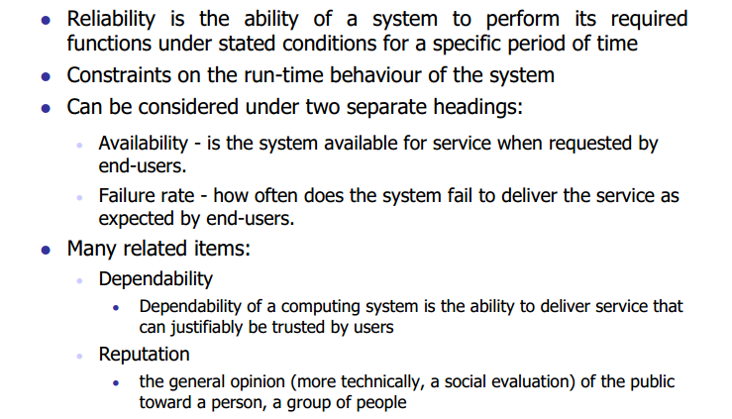
Reliability

Slide 10
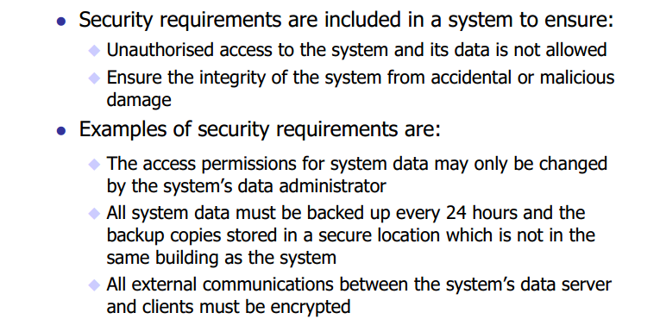
Security

Slide 11
Safety
Safety engineering is the engineering discipline within systems engineering that lowers the risk of accidental harm to valuable assets to an acceptable level to legitimate stakeholders.
Accidental harm to valuable assets is prevented, detected, reacted, and adapted
Accidents (and near misses) are eliminated or their negative consequence mitigated
Hazards are eliminated or mitigated
Safety risks are acceptably low

Slide 12
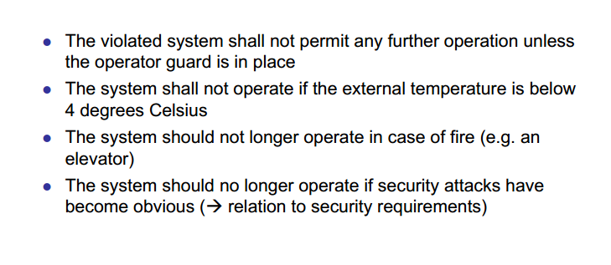
Example

Slide 13
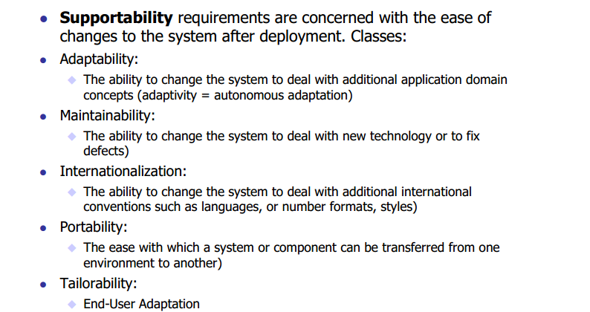
Supportability

Slide 14
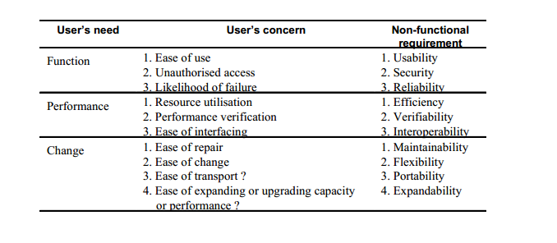
Relationships between user needs, concerns and NFRs

Slide 15
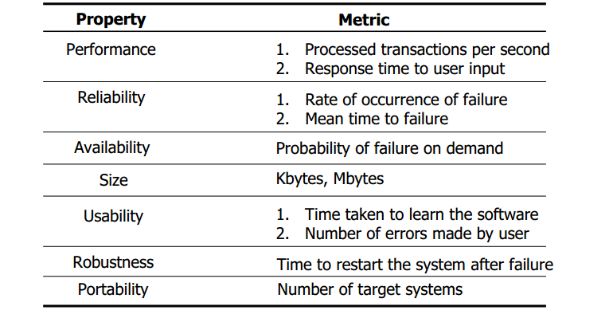
Examples of measurable metrics for Non-functional requirements

Slide 16
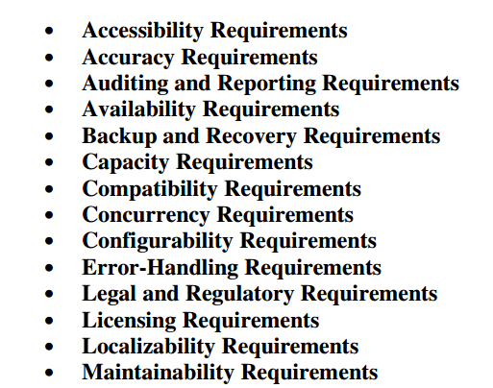
Other NFRs

